Slide 1
Addressing Inter-Class Similarity, Intra-Class Diversity, and Data Limitations in Chest X-ray Classification for Pneumonia Disease Using Triplet Loss Function and Transfer Learning.
Raphael Ogbodo & Ian Ferree
May 6, 2025

Slide 2
Outline
Pneumonia: Disease Overview
Chest X-ray as Diagnostic Tool
Challenges in Pneumonia Detection
Deep Learning for Medical Imaging
Inter-Class Similarity & Intra-Class Diversity
Discriminative Embedding with Triplet Loss
ResNet18-Based Architecture
Conclusions

Slide 3
Pneumonia: Disease Overview
Inflammation of lung parenchyma due to infection
Common causes: Bacteria, viruses, fungi
Symptoms: Cough, fever, shortness of breath
Global health burden: High morbidity and mortality
Diagnosed through use of chest x-rays

Slide 4
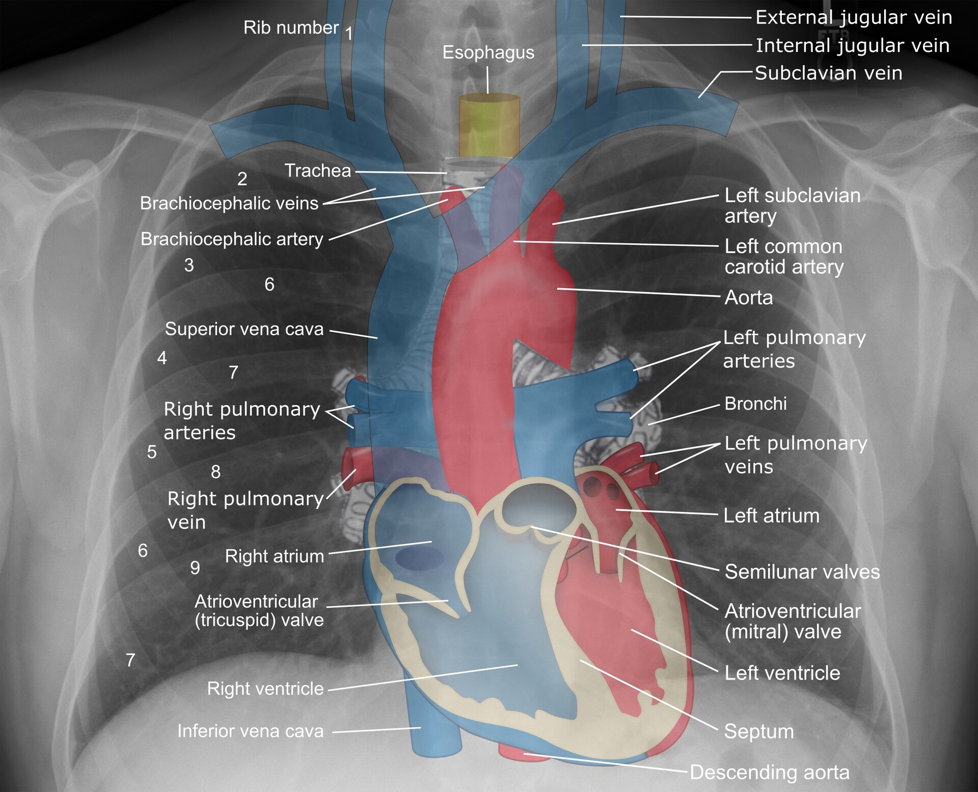
Chest X-ray as Diagnostic Tool
https://cdn.storymd.com/optimized/rA3VvrC4qM/original.jpg

Slide 5
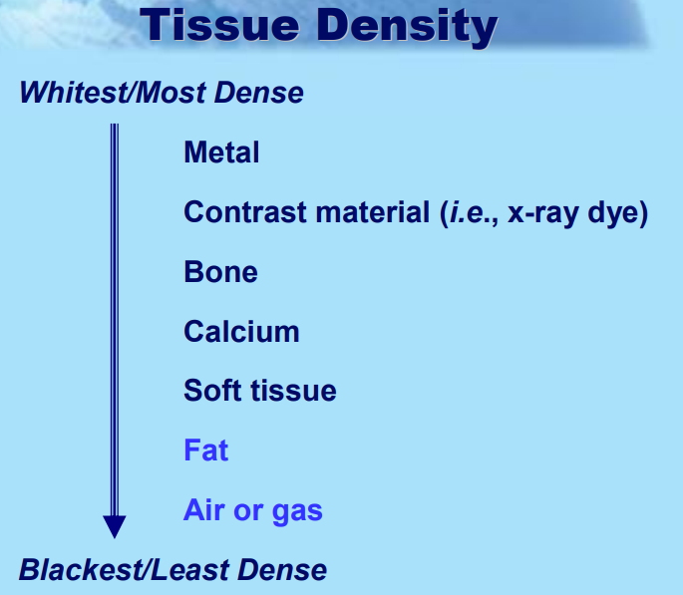
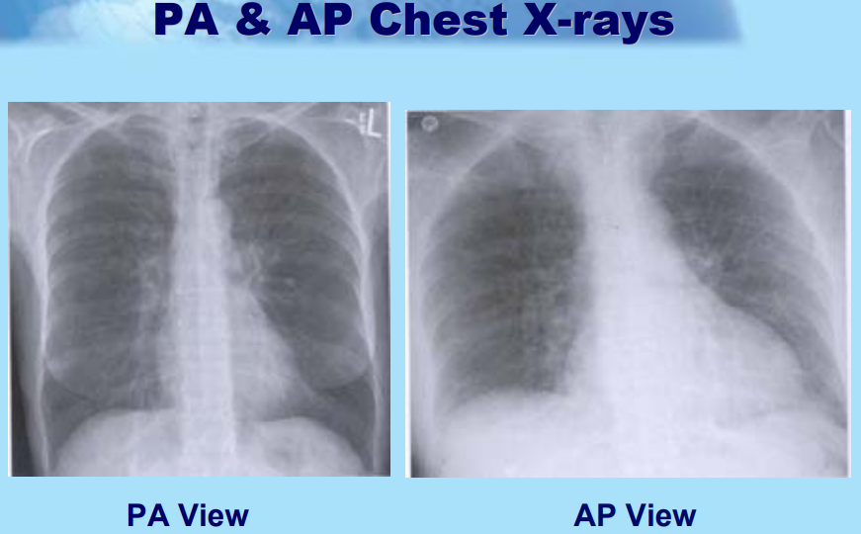
Chest X-ray as Diagnostic Tool
Widely used, cost-effective imaging modality
Visualizes lung opacities, consolidations
Essential for initial assessment and treatment planning
https://globaltb.njms.rutgers.edu/downloads/courses/Interpreting%20Chest%20Radiographs.pdf

Slide 6
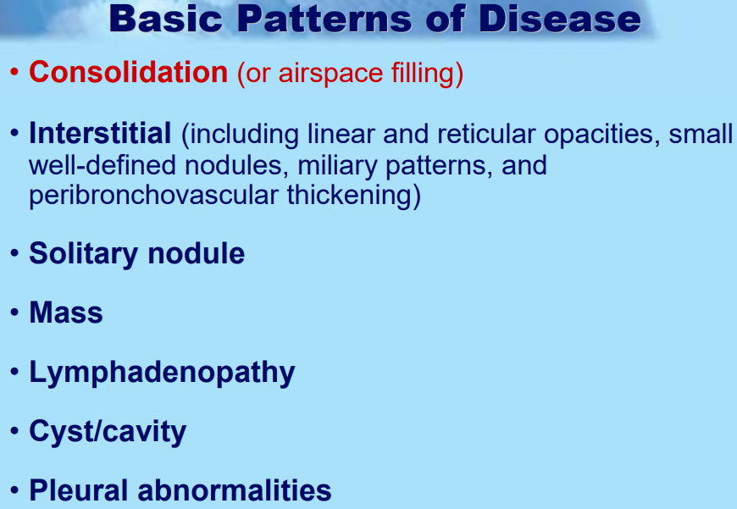
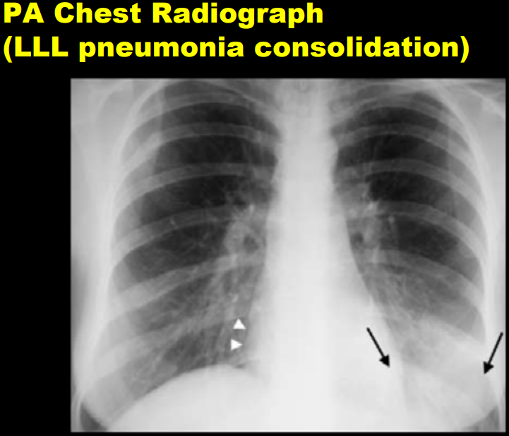
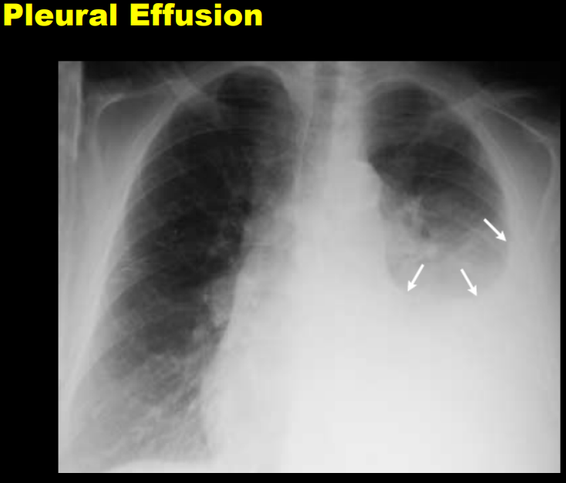
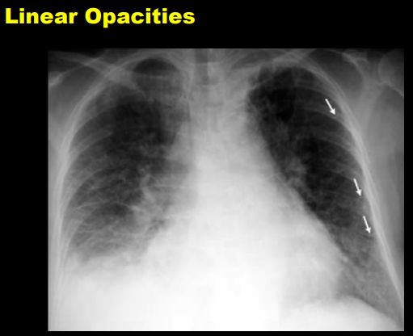
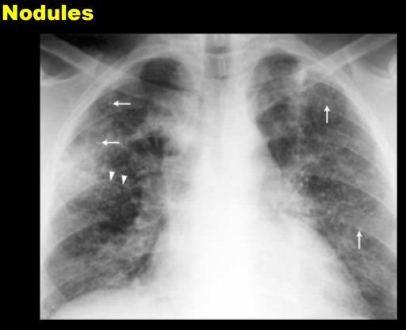
https://globaltb.njms.rutgers.edu/downloads/courses/Interpreting%20Chest%20Radiographs.pdf

Slide 7
Problem Statement
Due to significant visual similarities between healthy and pneumonia-infected lungs in chest X-ray images, traditional methods often struggle to accurately distinguish between the two, leading to misdiagnosis and reduced clinical reliability

Slide 8
Challenges in Pneumonia Diagnosis
Subjective interpretation by radiologists
Early-stage subtle indicators are hard to spot
Inter-reader variability leads to inconsistencies
Motivates the Application of Machine Learning/Deep Neural Networks

Slide 9
Impact of ML/DL on Pneumonia Detection/Diagnosis
Automated feature extraction from images
Reduced subjectivity and increased consistency
Ability to leverage transfer learning from large datasets
Improved sensitivity and specificity in detection

Slide 10
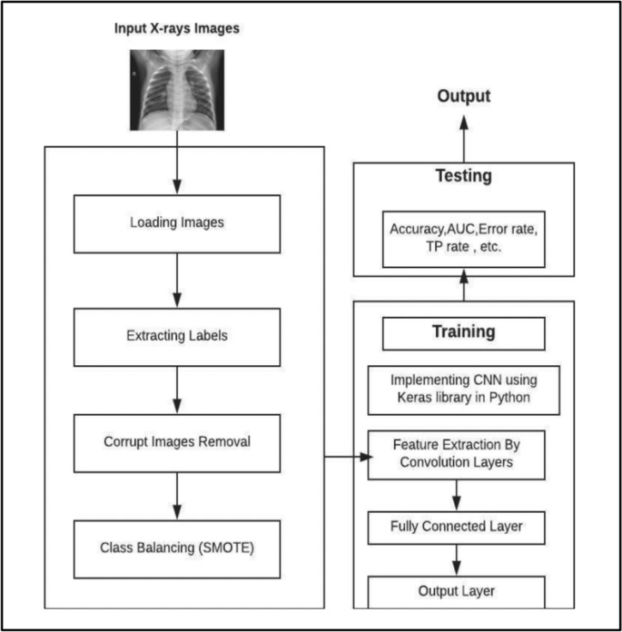
Literature Review - CNN
Accuracy: 84%

Slide 11
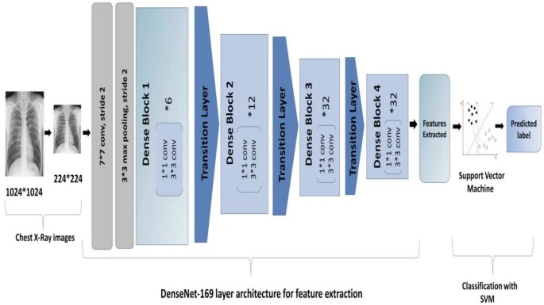
Literature Review – Pre-Trained Model
Training Accuracy: 95%
Validation Accuracy: 94%

Slide 12
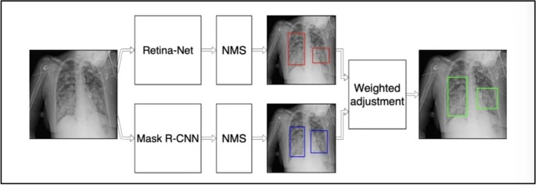
Literature Review - Ensemble
F1-Score: .286

Slide 13
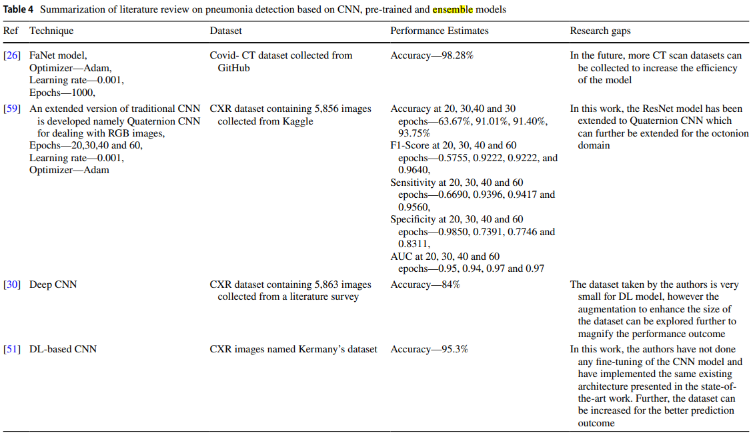
Literature Reviews

Slide 14
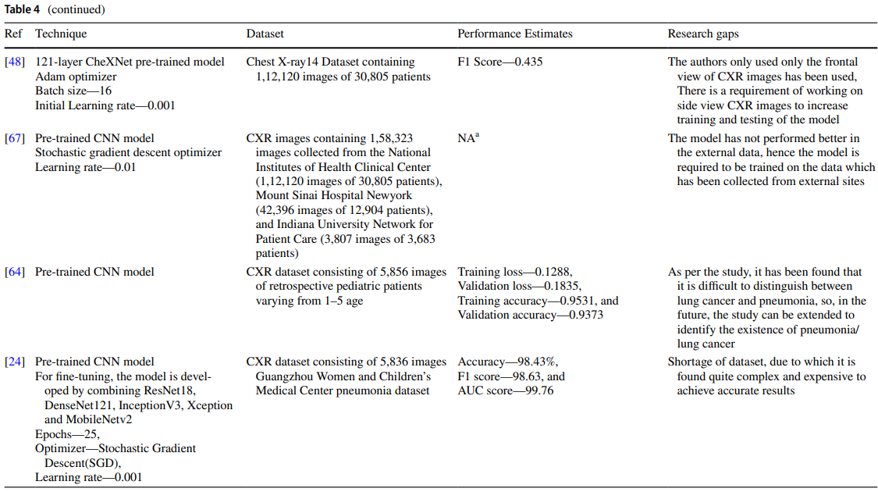
Literature Reviews

Slide 15
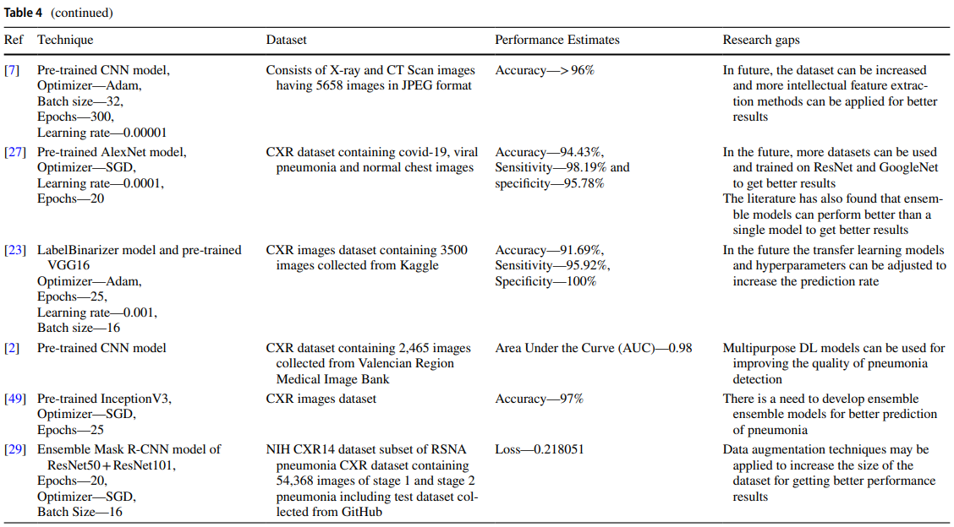
Literature Reviews

Slide 16
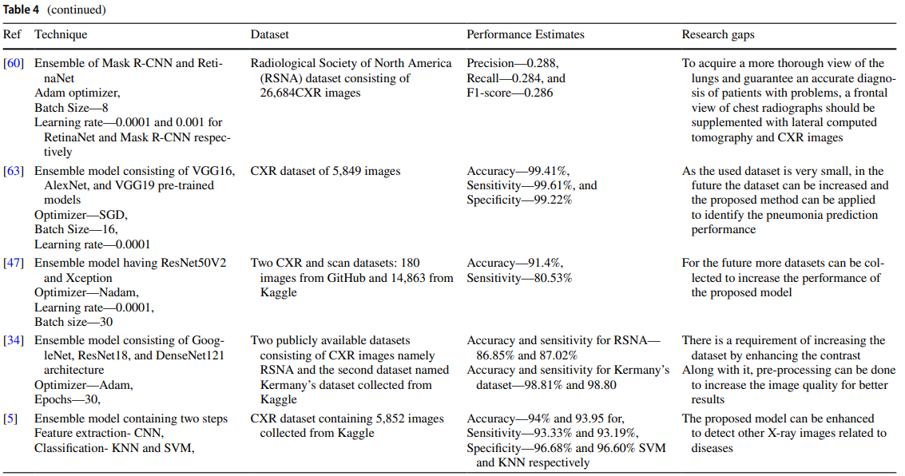
Literature Reviews

Slide 17
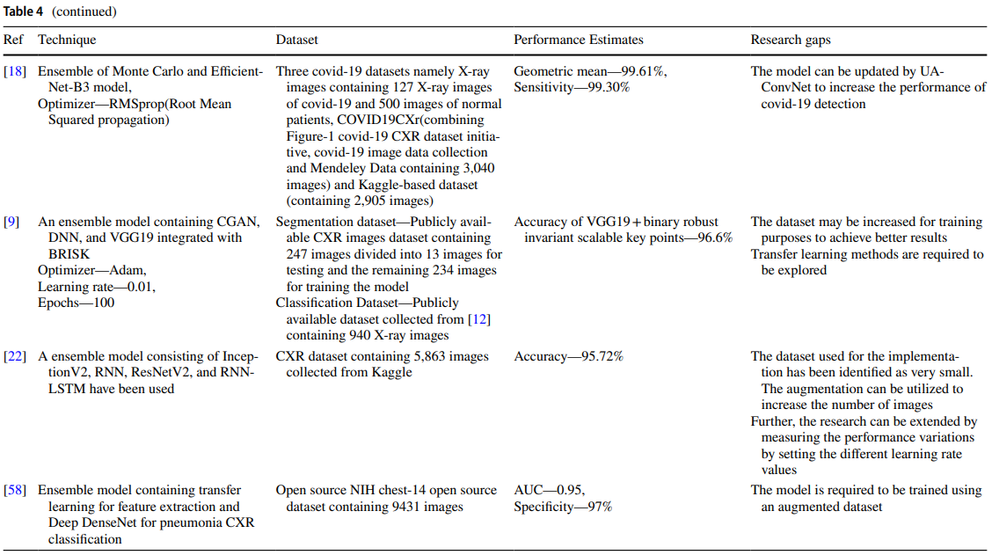
Literature Reviews

Slide 18
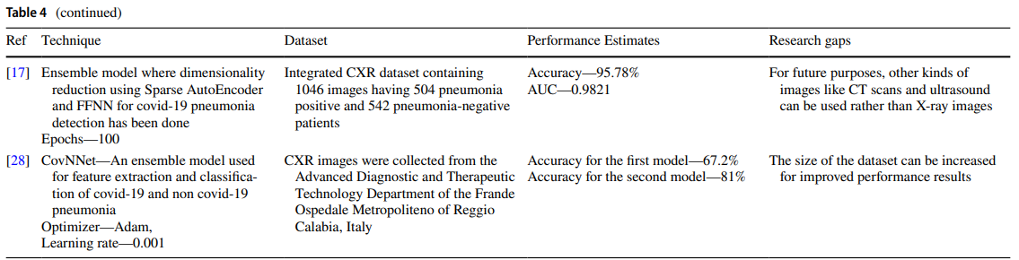
Literature Reviews

Slide 19
Dataset Introduction
We are working with Kermany Chest X-ray dataset from Kaggle.
The Dataset is made up of radiographs for healthy people labeled “Normal”
and Sick people labeled “Pneumonia”. Images include original, low-res, and
bicubic-upscaled.
Our Goal is to find problems within this datasets and proffer solutions for effective
Deep Learning application in Pneumonia detection.
https://doi.org/10.34740/KAGGLE/DSV/11132711

Slide 20
Problems within Chest X-ray Datasets that limits ML/DL Model Performance
Data limitations: Imbalanced datasets, limited annotations
Chest x-ray images of Normal and sick (Pneumonia) patients
Total Number of images 5856
Pre-split into train, validation, and test sets
Train: 1266 Normal & 3418 Pneumonia (80 % of Total images)
Validation: 158 Normal & 427 Pneumonia (10 % of Total images)
Test: 159 Normal & 428 Pneumonia (10 % of Total images)
27 % Normal 73 % Pneumonia
Most current classification models struggles to separate overlapping distributions

Slide 21
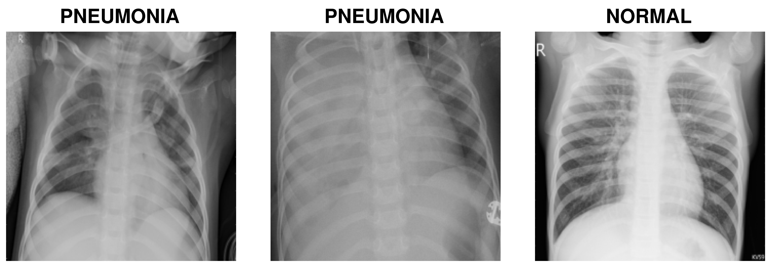
Problems within Chest X-ray Datasets that limits ML/DL Model Performance
Intra-Class Diversity: Variations within classes
Inter-Class Similarity: Overlap between healthy and diseased features.
Most current classification models struggles to separate overlapping distributions

Slide 22
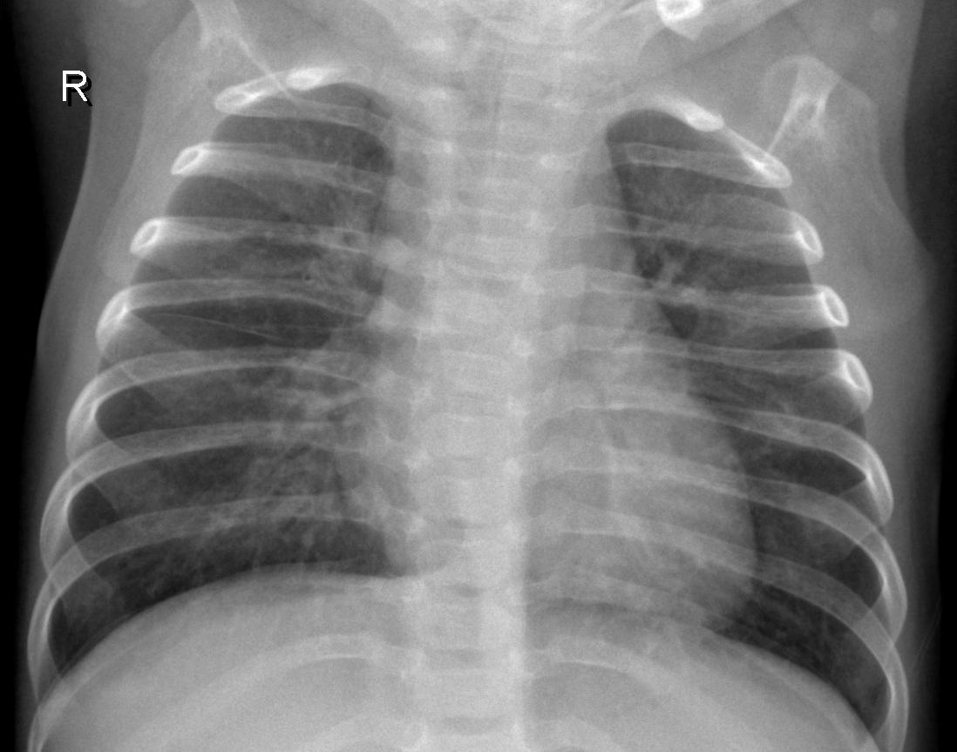
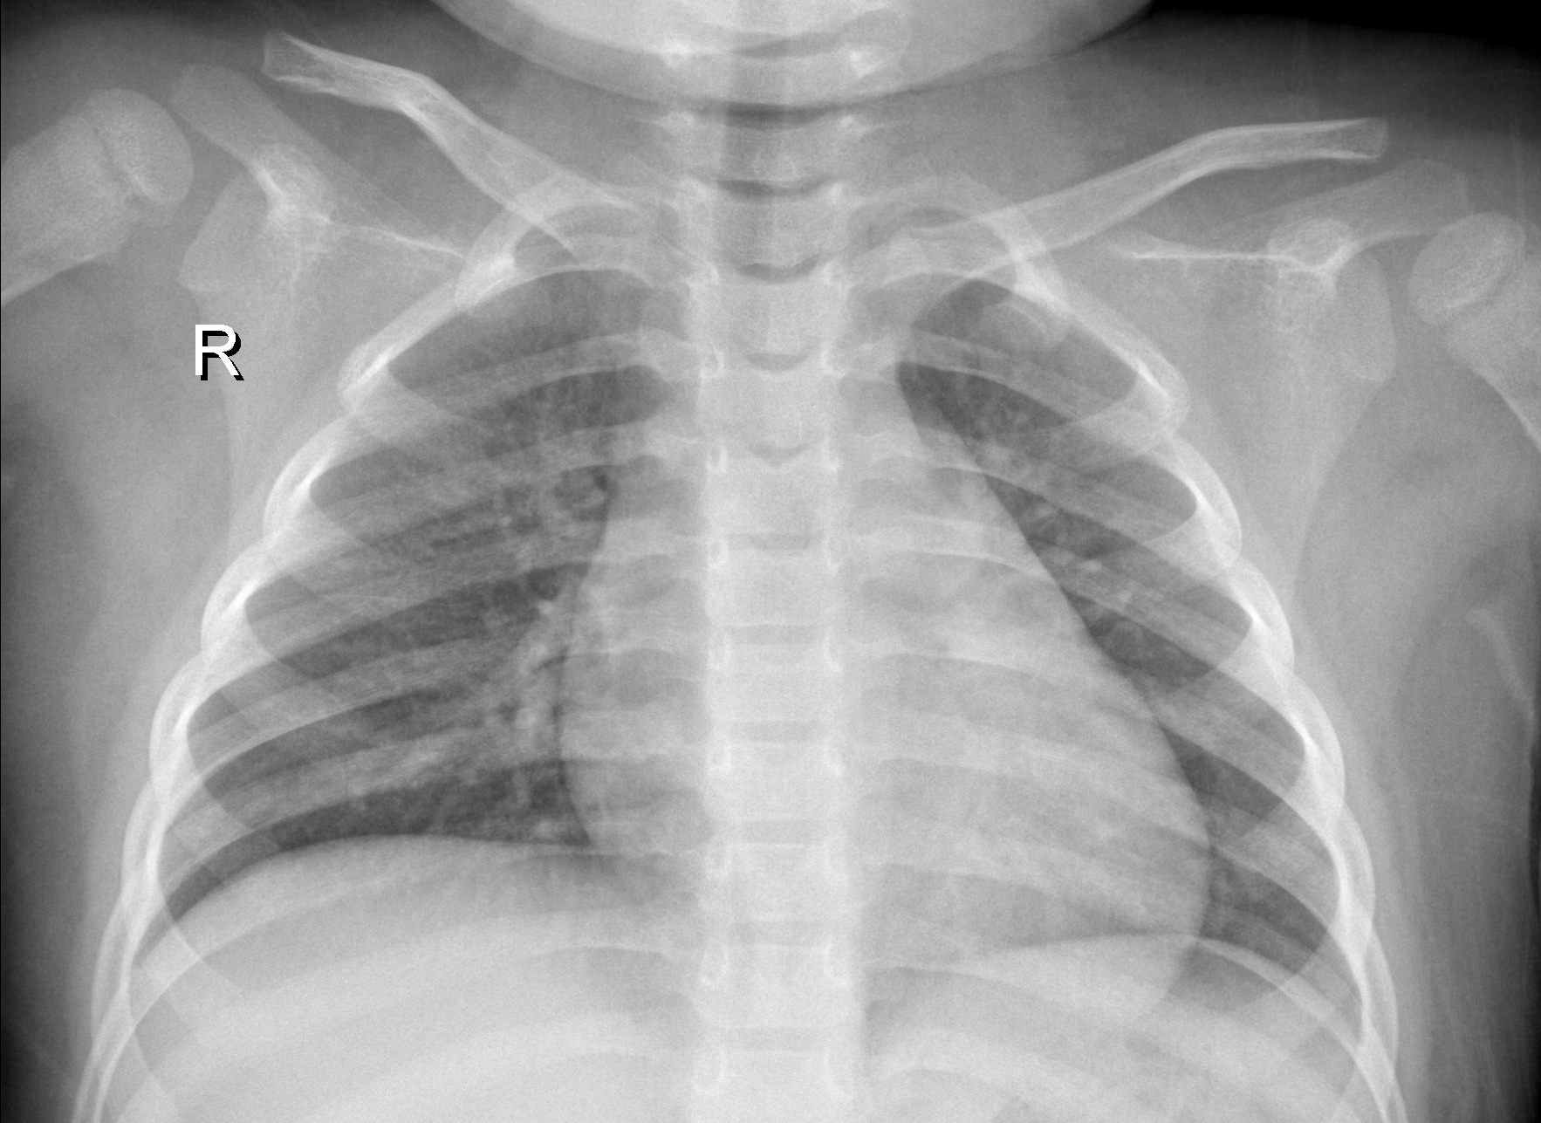
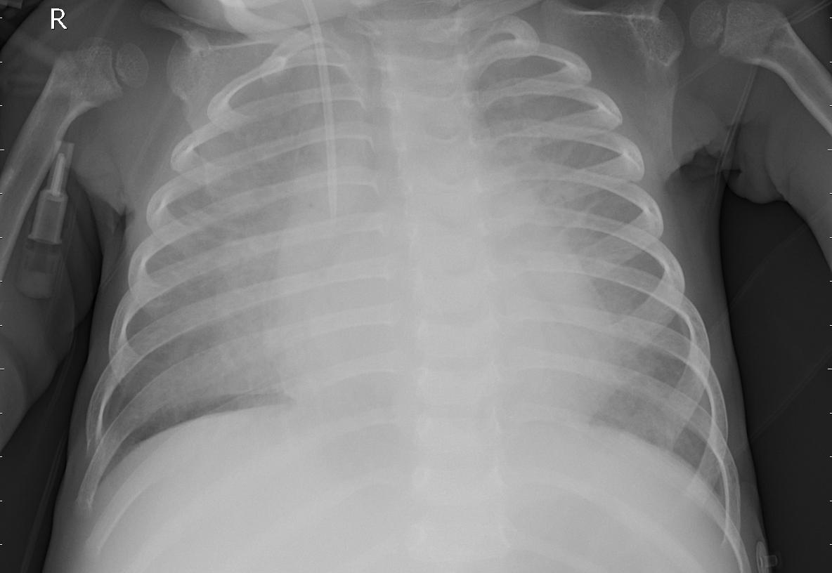
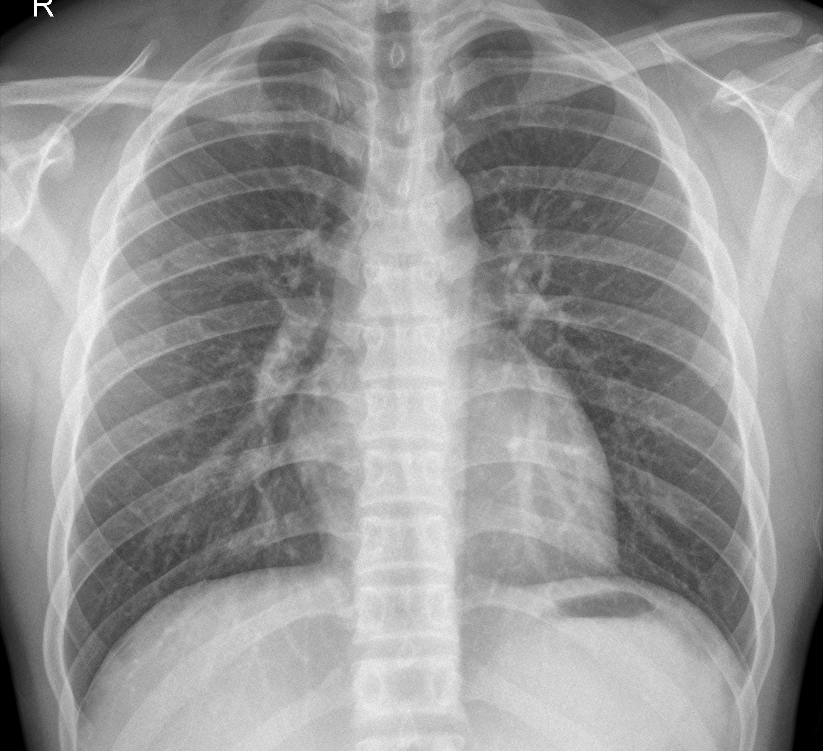
Which are Sick?
a
c
b
d
Sick
Healthy

Slide 23
Proposed Discriminative Embedding Based on ResNet18 Pretrained Model with Triplet Loss Function
Pretrained ResNet18 backbone for feature extraction
Transfer learning fine-tunes the model to the medical domain
Triplet Loss
Maximizes distance between different classes, minimizes within-class
Learns a robust embedding space for better separation
Mitigates inter-class similarity and enhances intra-class cohesion

Slide 24
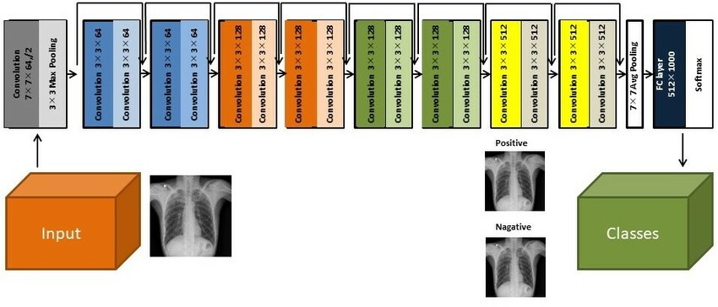
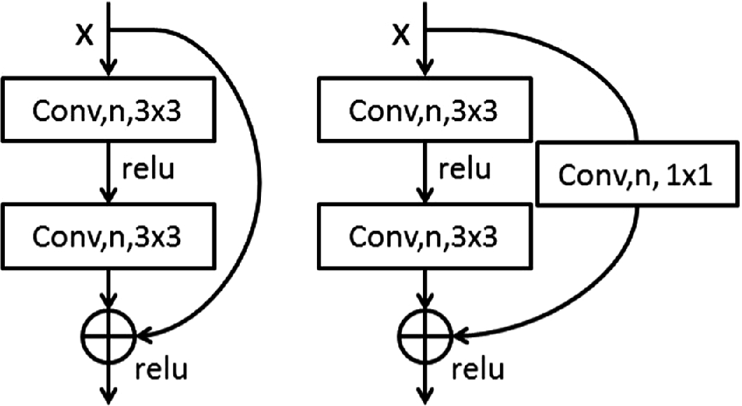
Pretrained ResNet18 backbone for feature extraction
S.H. Yoo et al 2020 JINST 15 P10011
10.1088/1748-0221/15/10/P10011
Atik, M.E and Duran, Z. Lecture Notes in Networks and Systems, 2021,vol 183. Springer.
https://doi.org/10.1007/978-3-030-66840-2_60

Slide 25
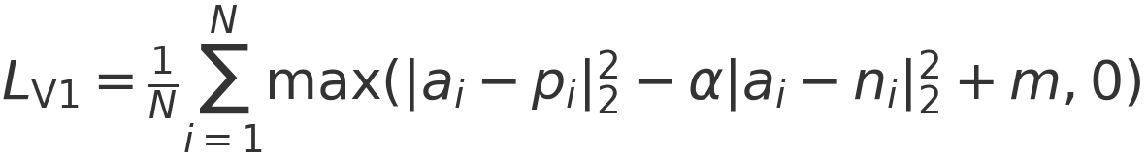
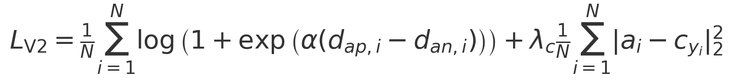
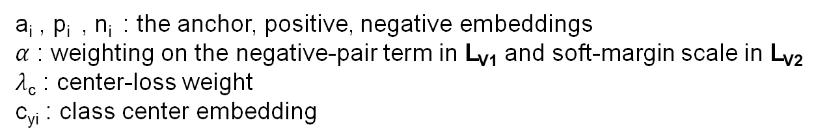
Proposed Triplet Loss Functions
Version 1: Squared-distance hinge triplet loss
Version 2: Soft-margin triplet + center loss
L_{triplet}
L_{center}
a_{i} , p_{i} , n_{i} : the anchor, positive, negative embeddings
$α$ : weighting on the negative-pair term in L_{V1} and soft-margin scale in L_{V2}
$λ$_{c} : center-loss weight
c_{yi} : class center embedding

Slide 26
Proposed Models/Methods Flow Diagram
ResNet18
Fine-tune Last Block Conv Layer
Input
L_{V1}
L_{V2}
FC
FC
Embeddings
FC
Embeddings
FC
FC
FC
SoftMax
SoftMax
FC
FC
Classes
Classes
FC
K-NN
FC
SoftMax
Classes
SoftMax
ResNet18
Classifier
Fine-tune ResNet18
Classifier
Classes
Classes
Embeddings
Classifiers V1 and V2
Data Flow
Classifier V1
Classifier V2

Slide 27
Proposed Models Based on Pre-trained ResNet18 Backbone
FC = Fully connected Layer
Model | Descriptions
Embeddings L_{V1} | An embedding model designed by replacing the FC layer of the ResNet18 with our 2 FC layers of 256 and 128 dimensions respectively. Proposed Triplet Loss version 1 (L_{V1}) was used here.
Embeddings L_{V2} | An embedding model designed by replacing the FC layer of the ResNet18 with our 2 FC layers of 256 and 128 dimensions respectively. Proposed Triplet Loss version 2 (L_{V2}) was used here.
Classifier L_{V1} | Here, the trained embeddings with L_{V1} is used as our backbone model. 2 FC layers of 128 dimension is used and final layer outputs the scores for each class (logits) used for classification.
Classifier L_{V2} | Here, the trained embeddings with L_{V2} is used as our backbone model. 2 FC layers of 128 dimension is used and final layer outputs the scores for each class (logits) used for classification.
Base ResNet18 | The ResNet18 pre-trained model with its FC layers replaced with our 128-dimensional 2 FC layers was used for classification.
Fine-tuned ResNet18 | The ResNet18 pre-trained model with its FC layers replaced with our 128-dimensional 2 FC layers was used for classification. The only modification different from the Base ResNet18 above is that we fine-tuned the weights of the last convolutional layer block.

Slide 28
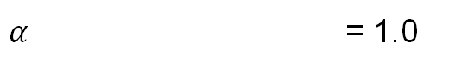
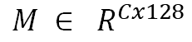
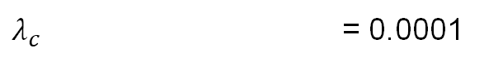
Image size and Hyperparameters
Image Size = 224 x 224 x 1
Batch size = 32
Epochs = 100
Learning Rate = 0.001
Optimizer = Adam
Embedding Loss = Triplet Loss (L_{V1} and L_{V2})
Classifier Loss = CrossEnropy with inverse frequency weights
FC Layer size = 128 for classifiers; 256 and 128 for Embeddings
Class centers =
$$M ∈ R^{Cx128}$$
$α$ = 1.0
$λ_{c}$ = 0.0001
Computational time = ~ 13 hours

Slide 29
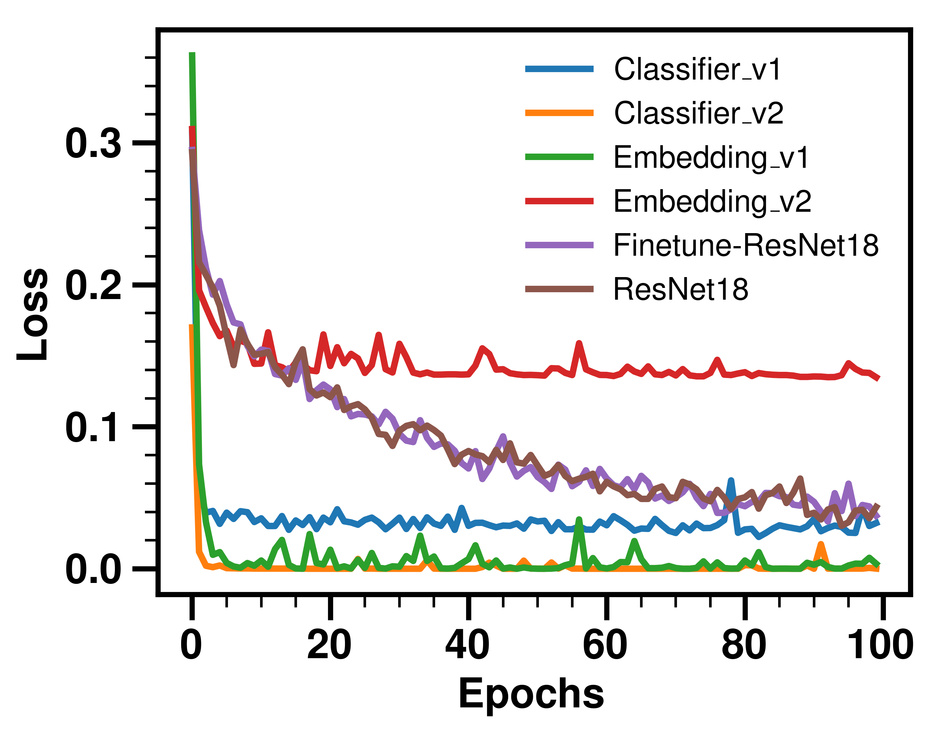
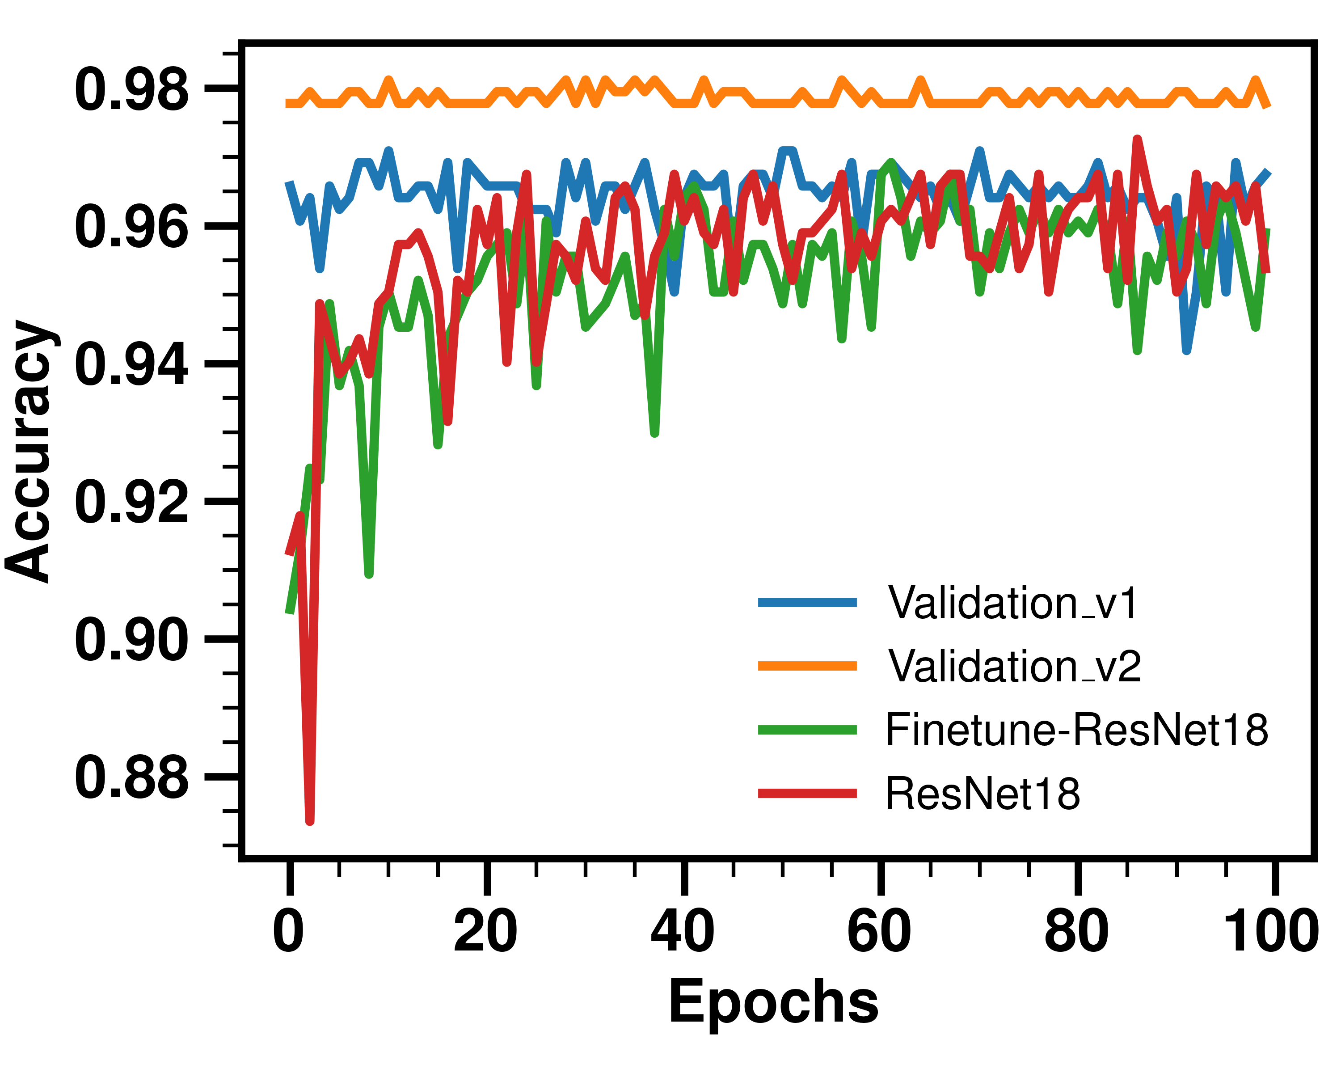
Training Losses and Validation Accuracy

Slide 30
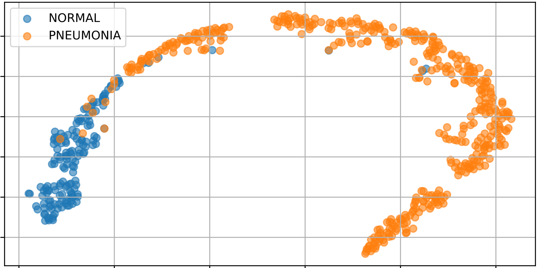
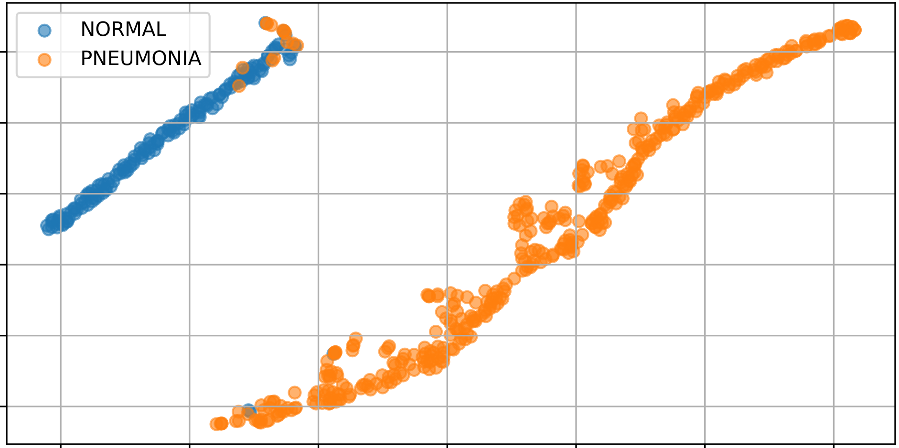
Learned Embedding Visualizations Using t-SNE
with L_{V1}
with L_{V2}

Slide 31
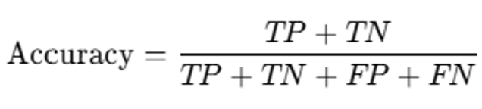
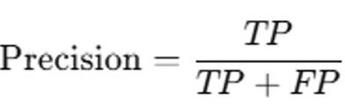
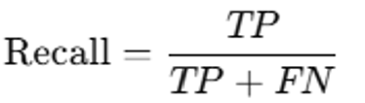
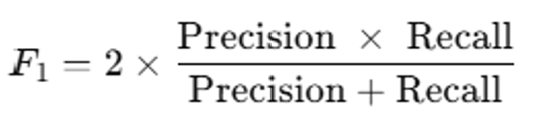
Metrics for Evaluation
Positive Predictive Value
Sensitivity or True Positive Rate
Harmonic Mean of Precision and Recall

Slide 32
Summary of Model Performance Metrics on the Test Sets
Model | Precision N P |  | Recall N P |  | F1 Score N P |  | Macro F1 Score | Weighted-Averaged F1 Score | Overall Accuracy
Embeddings L_{V1} | 0.95 | 0.97 | 0.93 | 0.98 | 0.94 | 0.98 | 0.96 | 0.97 | 0.968
Embeddings L_{V2} | 0.92 | 0.99 | 0.98 | 0.97 | 0.95 | 0.98 | 0.97 | 0.97 | 0.973
Classifier L_{V1} | 0.94 | 0.96 | 0.95 | 0.98 | 0.94 | 0.98 | 0.96 | 0.97 | 0.97
Classifier L_{V2} | 0.98 | 0.98 | 0.95 | 0.99 | 0.96 | 0.99 | 0.98 | 0.98 | 0.98
Base ResNet18 | 0.90 | 0.96 | 0.89 | 0.96 | 0.90 | 0.96 | 0.93 | 0.94 | 0.94
Fine-tuned ResNet18 | 0.89 | 0.96 | 0.91 | 0.96 | 0.90 | 0.96 | 0.93 | 0.95 | 0.95

Slide 33
Conclusions
Deep learning addresses subjective interpretation
Triplet loss enhances discriminability in embeddings
ResNet18 transfer learning accelerates convergence

Slide 34
References
Sharma, S., Guleria, K. A systematic literature review on deep learning approaches for pneumonia detection using chest X-ray images. Multimed Tools Appl 83, 24101–24151 (2024). https://doi.org/10.1007/s11042-023-16419-1
Ke-Kun Huang, Chuan-Xian Ren, Hui Liu, Zhao-Rong Lai, Yu-Feng Yu, Dao-Qing Dai. Hyperspectral image classification via discriminative convolutional neural network with an improved triplet loss. Pattern Recognition,112, 2021, 107744. https://doi.org/10.1016/j.patcog.2020.107744.
Jakhar K, Hooda N (2018) Big Data Deep Learning Framework using Keras: A Case Study of Pneumonia Prediction. In: 2018 4th International Conference on Computing Communication and Automation (ICCCA). pp 1–5
Varshni D, Thakral K, Agarwal L et al (2019) Pneumonia Detection Using CNN based Feature Extraction. In: 2019 IEEE International Conference on Electrical, Computer and Communication Technologies (ICECCT). pp 1–7
Sirazitdinov I, Kholiavchenko M, Mustafaev T et al (2019) Deep neural network ensemble for pneumonia localization from a large-scale chest x-ray database. Comput Electr Eng 78:388–399. https://doi.org/10.1016/j.compeleceng.2019.08.004
Daniel Kermany et al. (Original dataset authors), and Assem ElQersh (Restructured/Modified version). (2025). Chest X-ray Dataset (Pneumonia) [Data set]. Kaggle. https://doi.org/10.34740/KAGGLE/DSV/11132711

Slide 35
Thank You
Questions?

Slide 36
Team Members Contributions
Raphael Ogbodo
Designed the model architecture and the proposed loss function
Preprocess dataset
Train the model on the dataset
Analyzed and interpreted the results
Made some of the slides
Ian Ferree
Searched for problems within the dataset
Literature review
Pneumonia and x-ray research
Organization of slides
Made some of the slides

